Slide 1
ACID Properties

Slide 2
1. A: Atomicity (All or Nothing)
• Ensures that a transaction executes completely
or not at all.
• If any part of a transaction fails, all changes are
rolled back to maintain consistency.
• Example: Transferring ₹1000 from Account A to
Account B
• Debit from Account A
• Credit to Account B
• If either fails, no money should be deducted/added.

Slide 3
Example
START TRANSACTION;
UPDATE accounts SET balance = balance - 1000
WHERE account_id = 1; -- Debit
UPDATE accounts SET balance = balance + 1000
WHERE account_id = 2; -- Credit
-- Simulating failure
ROLLBACK; -- Reverts changes if any step fails

Slide 4
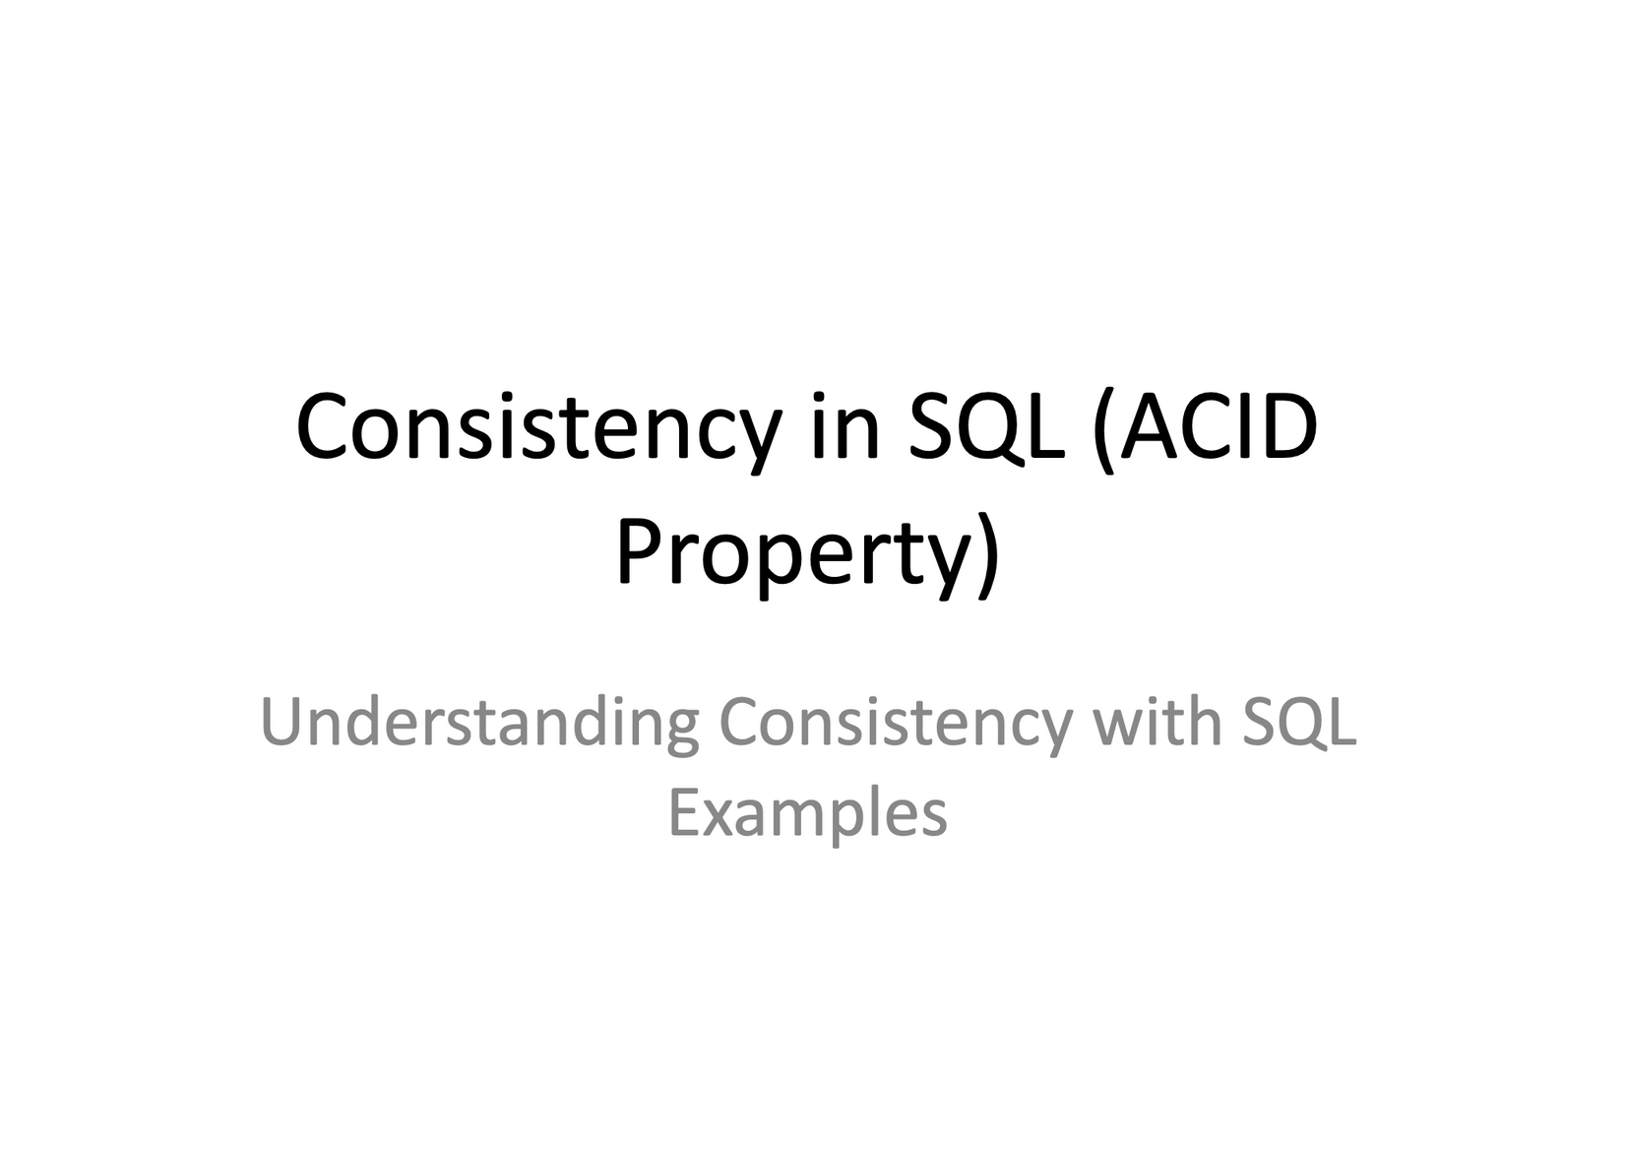

Slide 5
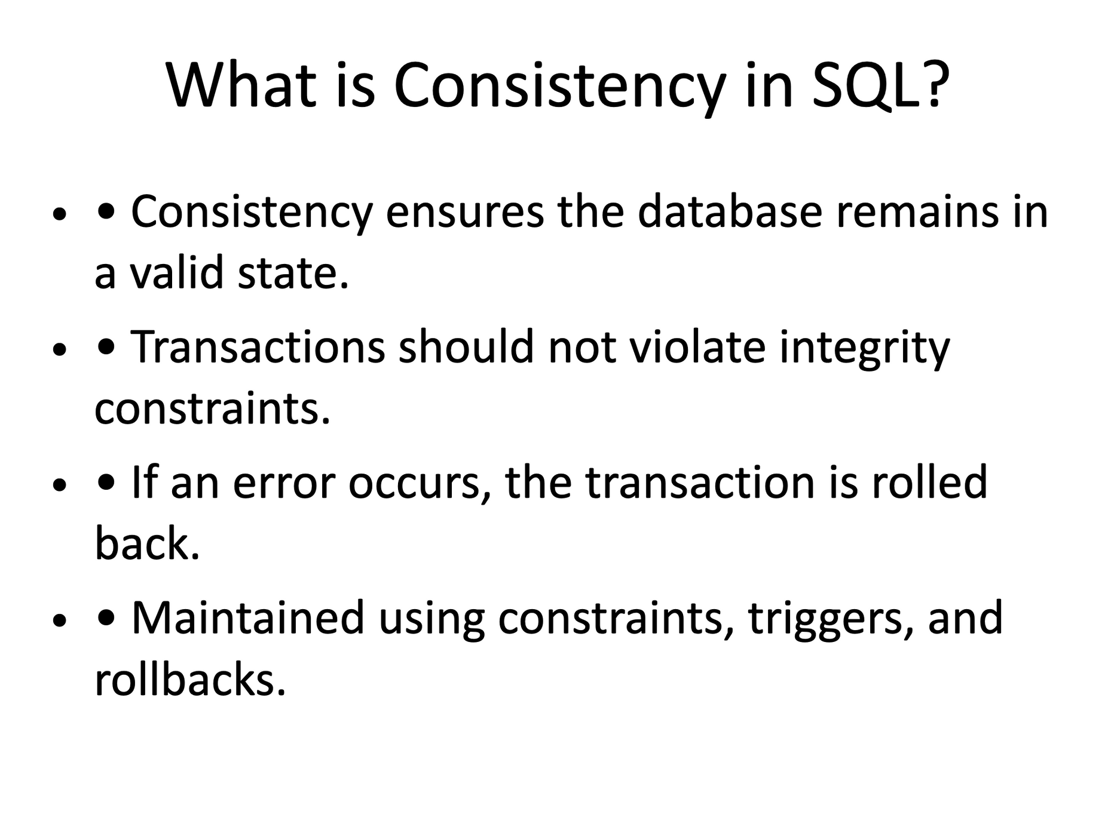

Slide 6
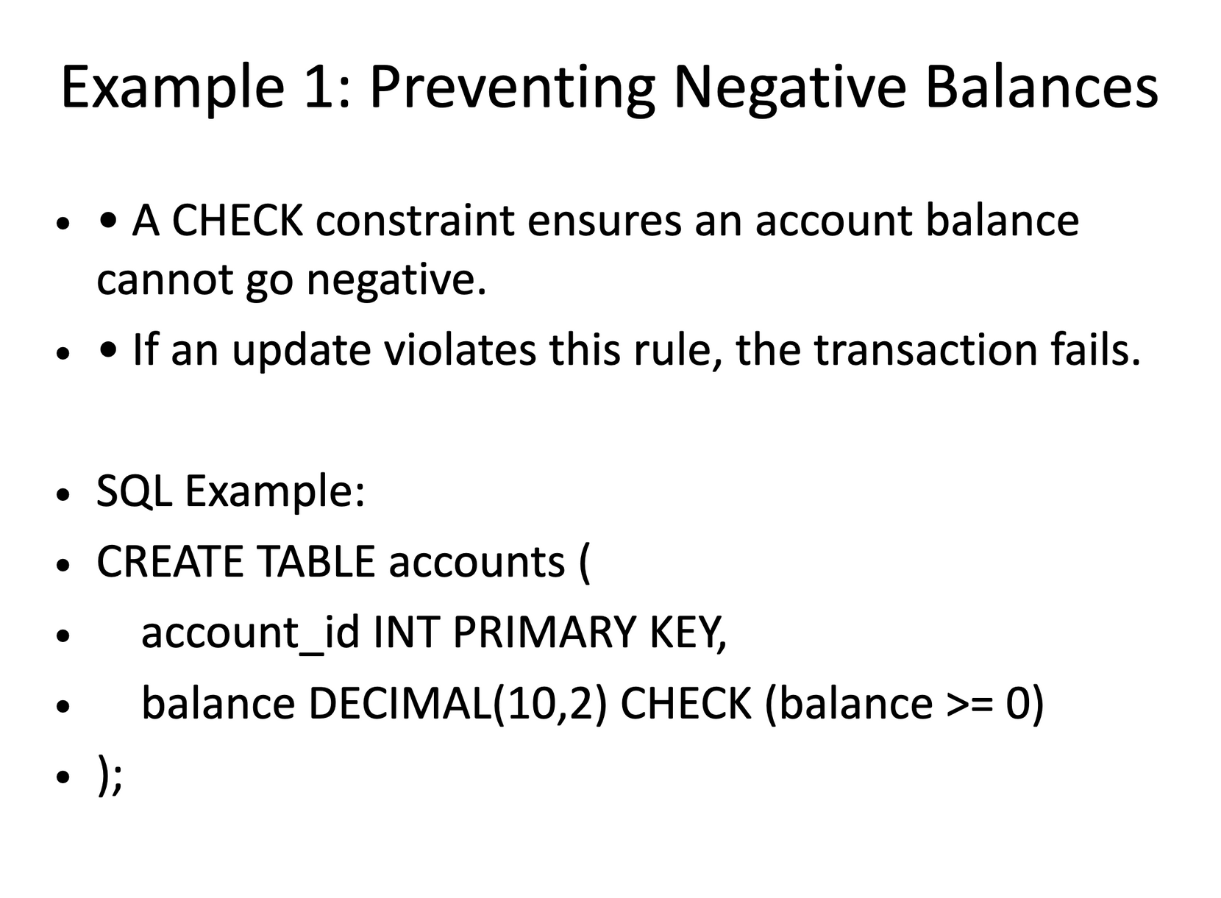

Slide 7
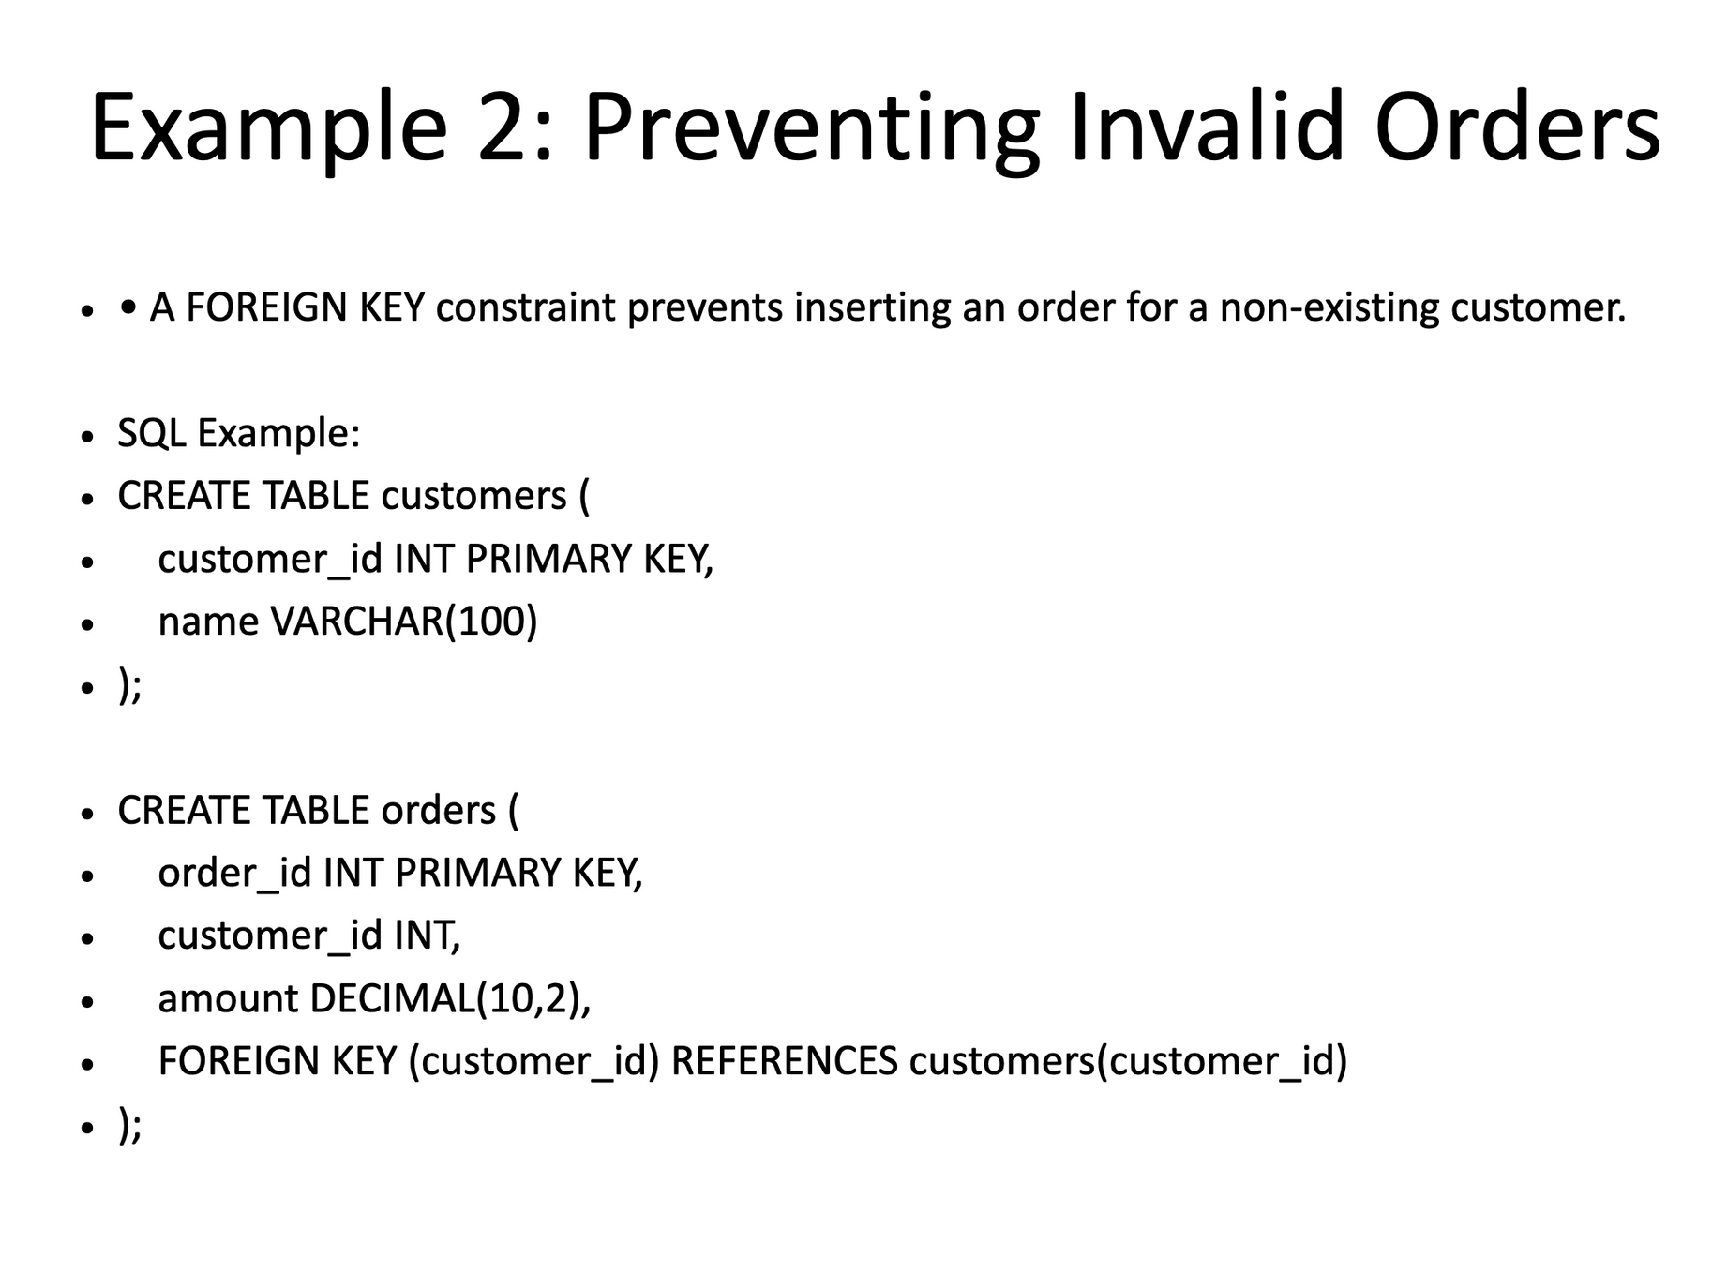

Slide 8
